Slide 1
Gaming Sales and Customer Behaviour Insights

Slide 2
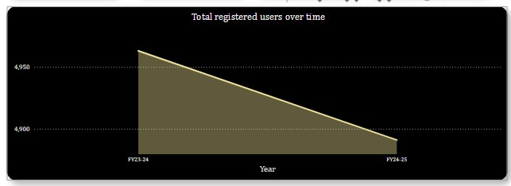
The number of new users has declined by 1.45% in FY 2024-25 compared to the previous fiscal year.
Despite decline in total new users for FY 2024-25, growth was observed among new female customers (+1.96%) and teenage customers (+5.47%).
Among all new teenage customers, 28.24% have joined organically, without any referral source, indicating a strong natural appeal and potential for sustained growth.

Slide 3
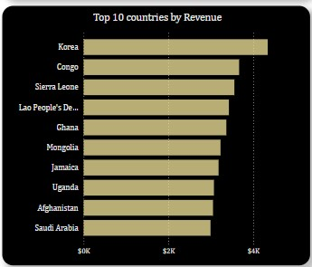
In the last 15 days, 46.82% of users have been inactive, but narrowing the window to the last 10 days sees a sharp increase to 64%, highlighting a significant drop in recent engagement and potential risk of churn.
Top 10 countries by revenue collected
Among these countries, all except Sierra Leone and the bottom four have shown positive growth in new customers.
In Korea, while the number of new customers has increased, inactivity among those who signed up in FY 2024-25 is higher by 20.39%
In Korea, BattleZone stands out with both a higher number of users and strong engagement, while SpeedRun and QuestRaid show inactivity rates exceeding 60%

Slide 4
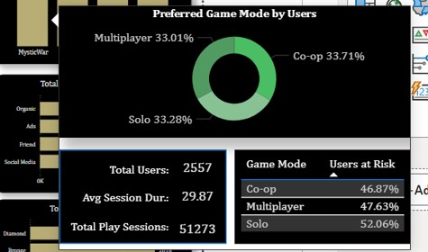
In this fiscal year, users without a subscription plan outnumber those with a subscription, and their numbers have grown. Additionally, Free users show the highest active user percentage in the last 10 days, while Platinum users have the lowest activity rate.
MysticWar is showing an interesting pattern, where new users are relatively more active than those who registered last year, defying the usual expectation of higher inactivity among newcomers.
Except for SpeedRun, all other games show the highest inactivity among users who prefer solo mode, with MysticWar having the highest percentage of inactive solo players.

Slide 5
Thank You

